Slide 1
Matroids, Submodular Functions

Slide 2
Outline
Matroids (Recap)
Submodular Functions
Relationship

Slide 3
Subset System, Hereditary Property
Set S
Non-empty collection of subsets I
Property: If X ∈ I and Y⊆X, then Y ∈ I
(S, I) is a subset system

Slide 4
Matroid, Exchange Property
Subset system (S, I)
Property: If X, Y ∈ I and |X| < |Y| then
there exists a s ∈ Y\X
such that X∪{s} ∈ I
M = (S, I) is a matroid

Slide 5
Matroids
(S, I) is a matroid
⟺
(S, I) admits an optimal greedy algorithm

Slide 6
Uniform Matroid
S = {1,2,…,m}
X ⊆ S
I = Set of all X ⊆ S such that |X| ≤ k

Slide 7
Graphic Matroid
G = (V, E), S = E
X ⊆ S
X ∈ I if X is a forest

Slide 8
Linear Matroid
Matrix A of size n x m, S = {1,2,…,m}
X ⊆ S, A(X) = set of columns of A indexed by X
X ∈ I if and only if A(X) are linearly independent

Slide 9
Independent Set
Matroid M = (S, I)
X ⊆ S is independent if X ∈ I
X ⊆ S is dependent if X ∉ I

Slide 10
Base of a Subset
Matroid M = (S, I)
X is a base of U ⊆S if it satisfies three properties
(i) X ⊆ U
(ii) X ∈ I
(iii) There exists no U’∈I, such that X ⊂ U’ ⊆ U
Inclusionwise maximal
independent
subset of U

Slide 11
An Interesting Property
M = (S, I) is a subset system
M is a matroid
⟺
For all U ⊆ S, all bases of U have same size

Slide 12
Rank of a Subset
Matroid M = (S, I)
U ⊆S
r_{M}(U) = Size of a base of U

Slide 13
Base of a Matroid
Matroid M = (S, I)
X is a base S

Slide 14
Rank of a Matroid
Matroid M = (S, I)
r_{M} = Rank of S

Slide 15
Weight of an Independent Set
Matroid M = (S, I)
Weight function w: S → Non-negative Real
Weight of an independent set X
w(X) = ∑_{s∈X} w(s)

Slide 16
Maximum Weight Independent Set
Matroid M = (S, I)
Weight function w: S → Non-negative Real
Find an independent set with maximum weight
max_{X∈I} ∑_{s∈X} w(s)

Slide 17
Greedy Algorithm
X ← ϕ
Repeat
s* = argmax_{x∈S\X} w(s)
such that X ∪ {s} ∈ I
X ← X ∪ {s}
Until no more elements can be added

Slide 18
Optimality: Sufficiency
(S, I) is a matroid
⟺
(S, I) admits an optimal greedy algorithm

Slide 19
Outline
Matroids
Submodular Functions
Relationship

Slide 20
Submodular Function
Set S
Function f over power set of S
f(T) + f(U) ≥ f(T ∪ U) + f(T ∩ U)
for all T, U ⊆ S

Slide 21
Supermodular Function
Set S
Function f over power set of S
f(T) + f(U) ≤ f(T ∪ U) + f(T ∩ U)
for all T, U ⊆ S

Slide 22
Modular Function
Set S
Function f over power set of S
f(T) + f(U) = f(T ∪ U) + f(T ∩ U)
for all T, U ⊆ S

Slide 23
Modular Function
f(T) = ∑_{s ∈T} w(s) + K
Is f modular?
YES
All modular functions have above form?
YES
Prove at home

Slide 24
Outline
Matroids
Submodular Functions
Diminishing Returns
Examples
Relationship

Slide 25
Diminishing Returns
Define d_{f}(s|T) = f(T ∪{s}) - f(T)
Gain by adding s to T
If f is submodular, d_{f} (s|T) is non-increasing

Slide 26
Diminishing Returns
Define d_{f}(s|T) = f(T ∪{s}) - f(T)
Gain by adding s to T
Proof?
f(U ∪ {s}) + f(U ∪ {t}) ≥ f(U) + f(U ∪{s,t})
for all U⊆ S and distinct s,t ∈ S\U
Necessary condition for submodularity

Slide 27
Diminishing Returns
Define d_{f}(s|T) = f(T ∪{s}) - f(T)
Gain by adding s to T
Prove at home
f(U ∪ {s}) + f(U ∪ {t}) ≥ f(U) + f(U ∪{s,t})
for all U⊆ S and distinct s,t ∈ S\U
Sufficient condition for submodularity

Slide 28
Outline
Matroids
Submodular Functions
Diminishing Returns
Examples
Relationship

Slide 29
Set Theory

Slide 30
Set Unions
T₁, T₂, …, T_{n} ⊆ T
S = {1, 2, … n}
Prove at home
f(U) = ∑_{s∈U’} w(s), U’ = ∪_{i∈U} T_{i}
Submodular
Non-negative weight w(s) of element s ∈ T
Minimum of f?
0
Is f non-decreasing?
YES

Slide 31
Graph Theory

Slide 32
Directed Graph Cuts
Digraph G = (V, A)
S = V
f(U) = ∑_{a∈out-arcs(U)} c(a)
Submodular
Proof?
Non-negative capacity c(a) of arc a ∈ A
Minimum of f?
0
Is f non-decreasing?
NO

Slide 33
Directed Graph Cuts
Digraph G = (V, A)
S = V
f(U) = ∑_{a∈out-arcs(U)} c(a)
Submodular
Proof?
Non-negative capacity c(a) of arc a ∈ A
Minimum of f over U ⊆ S\{t} such that s ∈ U?
Minimum s-t cut = Maximum s-t flow

Slide 34
Outline
Matroids
Submodular Functions
Relationship

Slide 35
Rank Function of Matroid
Matroid M = (S, I)
Rank function r
X is independent if and only if r(X) = |X|

Slide 36
Property of Rank Function
Set S
Proof?
Rank function of a matroid r
⟸
For all T, U ⊆ S
if T ⊆U
r(T) ≤ r(U) ≤ |U|

Slide 37
Property of Rank Function
Set S
Proof?
Hidden slides
Rank function of a matroid r
⟸
For all T, U ⊆ S
r(T ∪ U) + r(T ∩ U) ≤ r(T) + r(U)
Rank function of a matroid is submodular

Slide 38
Proof Sketch
Matroid M = (S, I)
X ⊆T∩U, X ∈I is inclusionwise maximal
Y ⊆T∪U, X ⊆ Y, Y ∈I is inclusionwise maximal
r(T∩U) = |X|
Why?

Slide 39
Proof Sketch
Matroid M = (S, I)
X ⊆T∩U, X ∈I is inclusionwise maximal
Y ⊆T∪U, X ⊆ Y, Y ∈I is inclusionwise maximal
r(T∪U) = |Y|
Why?

Slide 40
Proof Sketch
Matroid M = (S, I)
X ⊆T∩U, X ∈I is inclusionwise maximal
Y ⊆T∪U, X ⊆ Y, Y ∈I is inclusionwise maximal
r(T) ≥ |Y∩T|
Why?

Slide 41
Proof Sketch
Matroid M = (S, I)
X ⊆T∩U, X ∈I is inclusionwise maximal
Y ⊆T∪U, X ⊆ Y, Y ∈I is inclusionwise maximal
r(U) ≥ |Y∩U|
Why?

Slide 42
Proof Sketch
Matroid M = (S, I)
r(T) + r(U)
≥ |Y∩T| + |Y∩U|
= |Y∩(T∩U)| + |Y∩(T∪U)|
≥ |X| + |Y|
= r(T∩U) + r(T∪U)

Slide 43
MULTI-LINEAR EXTENSION
Dr. KOLLA BHANU PRAKASH
https://people.ece.uw.edu/bilmes/classes/ee563_spring_2018/lecture17_print.pdf

Slide 44
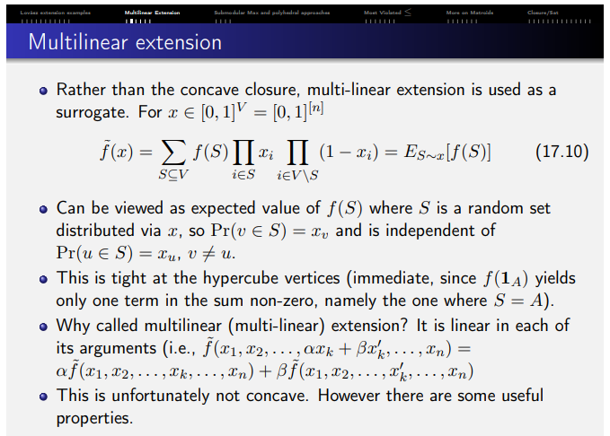
Multi-linear Extension

Slide 45
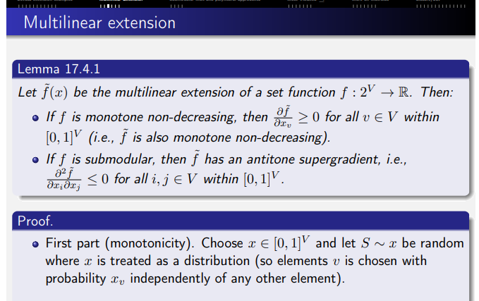
Multi-linear Extension

Slide 46
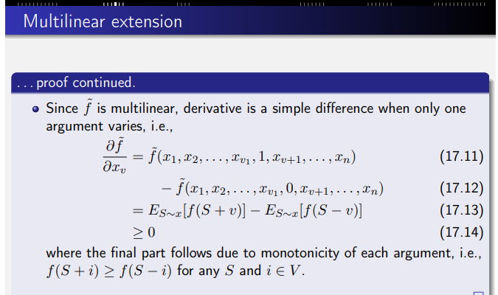
Multi-linear Extension

Slide 47
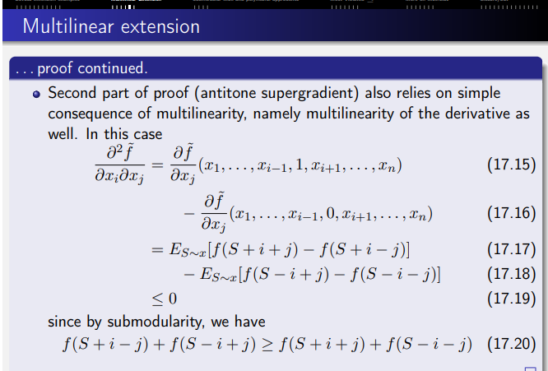
Multi-linear Extension

Slide 48
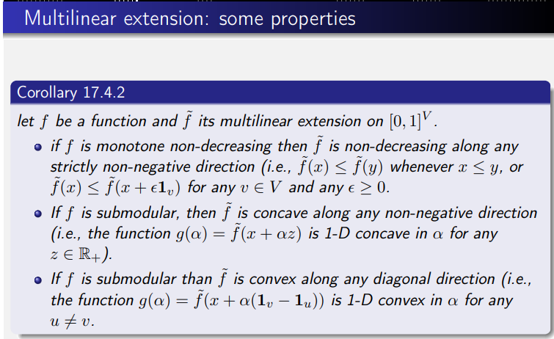
Multi-linear Extension

Slide 49
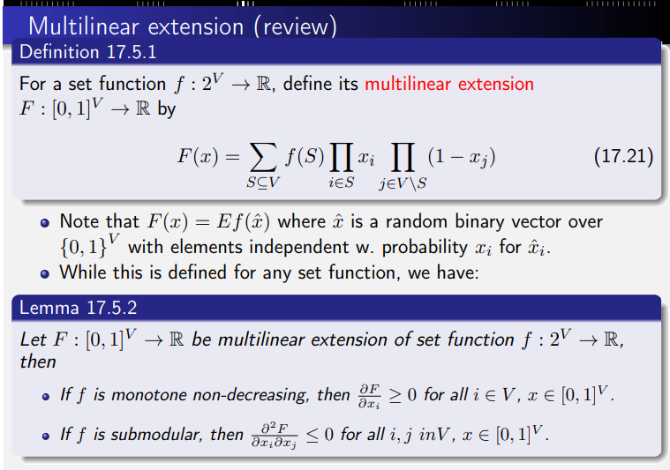
Multi-linear Extension

Slide 50


